Slide 1
END SEM PRESENTATION
FACE RECOGNITION SYSTEM
PREPARED BY
SANJEEV MALLICK
2021A7PS2217P

Slide 2

Introduction

Slide 3
INTRODUCTION
PROBLEM STATEMENT : We are given a dataset of images. Now, we are also given group photos. Our task is to find/identify the individual identities from the group photo using the given photos in the database.
SOLUTION: We can solve this problem by using the concept of Face Detection, Face Recognition and computer vision algorithms. We also have to store the images in a real-time database as well as output the results using database.

Slide 4

Resources

Slide 5
TECH STACK USED IN THE PROJECT
Python Programming Language
OpenCV (Open Computer Vision Library)
Tkinter (for the graphical user interface or GUI)
Python libraries which include Numpy, Pandas and Face-Recognition.
MySQL (Database)
Haar Cascade Features/Algorithms

Slide 6

Working and Implementation

Slide 7
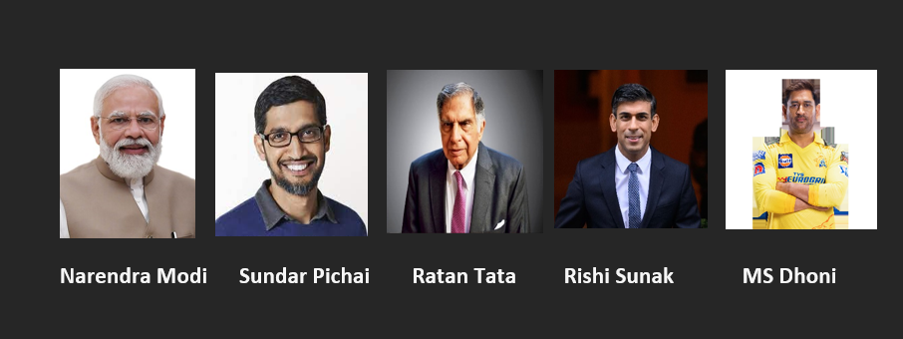
IMPLEMENTATION AND WORKING
Consider a image dataset

Slide 8
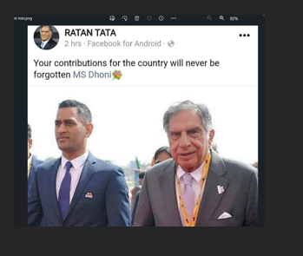
Now consider a simple group photo
Our target is to identify the names of the individuals from the group photo

Slide 9
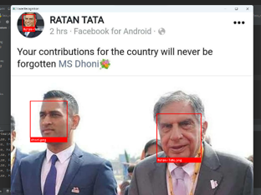
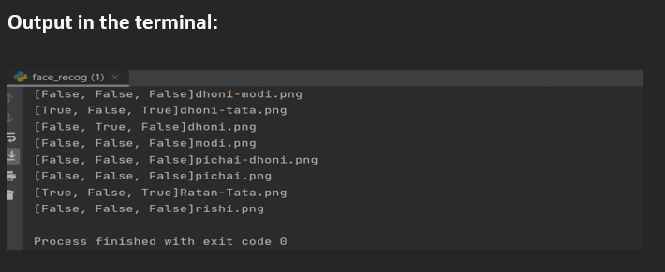
Now,to identify them,I had used the concepts of Face Detection,Face Recognition and Computer Vision.On running the program,we get the desired outputs.

Slide 10
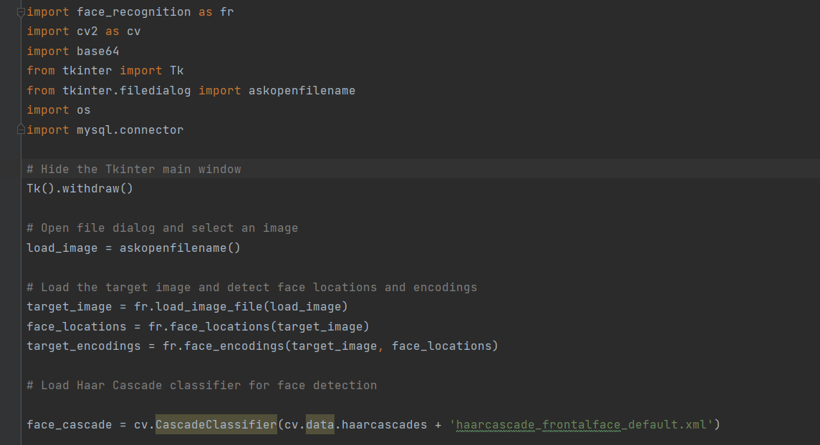
Code Snippets

Slide 11
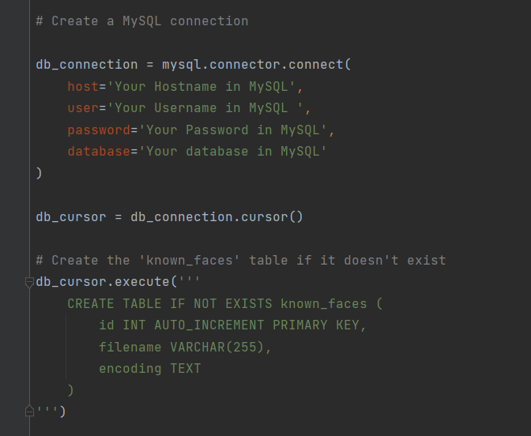
MySQL Database
connection setup
for storing the data

Slide 12
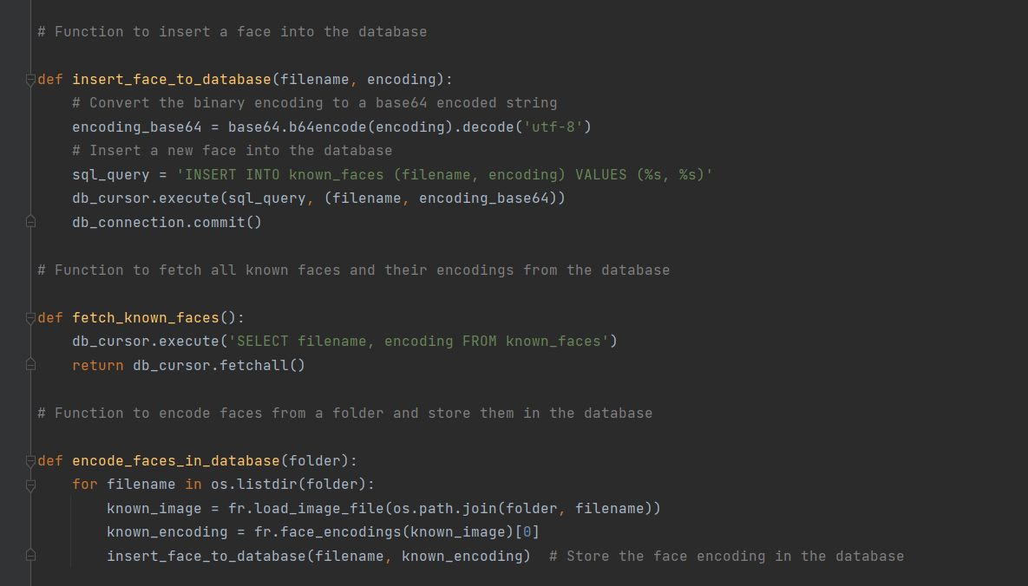

Slide 13
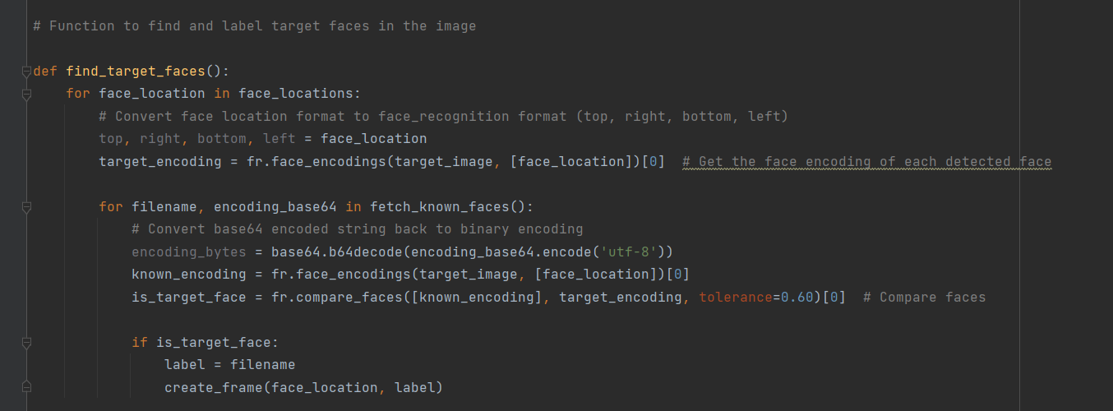

Slide 14
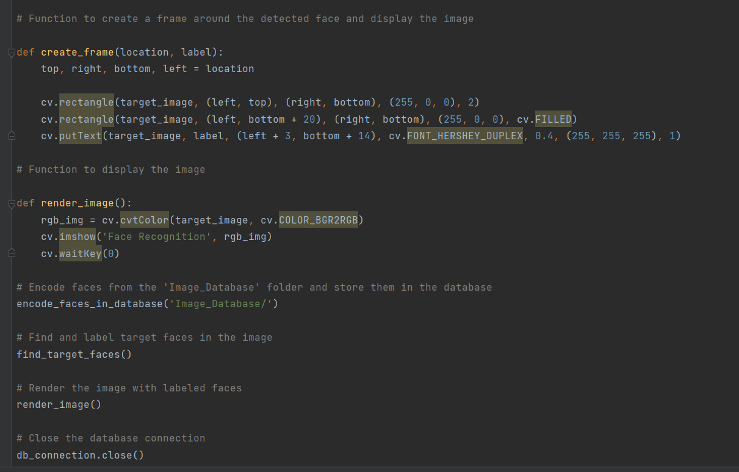

Slide 15
25
20
Results and Conclusions
15
10
5
0
Item 1
Item 2
Item 3
Item 4
Item 5

Slide 16
RESULT AND CONCLUSION
The system has demonstrated its ability to accurately detect and recognize individual faces within a group photo, overcoming challenges such as variations in lighting, expressions, and pose.
Overall, the system has demonstrated high accuracy in recognizing faces from group photos, making it a valuable tool in various applications, including security, social media, and human-computer interaction

Slide 17
ACKNOWLEDGEMENTS
1)BITS PILANI
2)Dr. Sunny Kumar Singh(Faculty In Charge)
3)Northcorp Software Pvt. Limited
4)Colleagues and Peers

Slide 18
THANK YOU

